Slide 1
FINANCIAL STATEMENT ANALYSIS
Topic 1: Framework for financial statement analysis
Presented by:
Dr. Judy Taylor
Lecturer
School of Economics and Finance

Slide 2
Student learning objectives
1.1 Discuss the general principles of the financial reporting system and explain the objectives of financial reporting according to the Financial Accounting Standards Board (FASB) conceptual framework;
1.2 Identify the two primary qualities of accounting information (i.e., relevance and reliability), the ingredients of relevance (i.e., predictive value, feedback value and timeliness), the ingredients of reliability (i.e., verifiability, neutrality and representational faithfulness), the two secondary qualities of accounting information (i.e., comparability and consistency), and discuss how these qualities provide useful information to an analyst;

Slide 3
Student learning objectives
1.3 Describe and explain the purposes of the five principal financial statements and discuss the additional sources of information accompanying the financial statements, including the financial footnotes, supplementary schedules, Management Discussion and Analysis (MD&A) and proxy statements;
1.4 Describe the format of the income statement and describe the components of net income;
1.5 Describe the format and the components of the balance sheet and the format, classification, and use of each component of the statement of stockholders’ equity;
1.6 Discuss the role of the auditor and the meaning of the audit opinion.

Slide 4
References
CFA Institute. (2007a). CFA® Level I Candidate Readings. CFA Institute: Charlottesville. Reading 37.
White, G. I., A. C. Sondhi and D. Fried. (2003). The Analysis and Use of Financial Statements. (3rd edition). Wiley. Chapter 1.

Slide 5
Objective 1.1
Financial reporting system
An understanding of the conceptual bases of the financial reporting system and the preparation of financial statements are essential prerequisites to financial analysis
The financial reporting system comprises five principal financial statements, supplemented by footnotes
  Balance sheet
  Income statement
  Statement of comprehensive income
  Statement of cash flows
  Statement of stockholders’ equity

Slide 6
Objective 1.1
General principles of financial reporting system
The financial reporting system depends on data generated by accounting events or transactions and selected economic events
The accrual system of accounting which is the cornerstone on which the financial reporting system is defined:
  Recognition principle: Revenue is recognised when goods are delivered or services performed and the associated expenses are recorded
  Matching principle: Revenues and associated costs are recognised in the same accounting period, not necessarily when cash is transferred
  Historical cost: The amount of cash or other resources originally exchanged for the asset or liability, is the basis on which most transactions are quantified
  Going concern principle: An assumption that the firm will operate indefinitely is the primary basis of financial reporting
Notes:
Exchange transactions include the exchange of cash or another asset for a different asset or to create or settle a liability
Events other than exchange transactions which are recognised in the financial accounts include:
Passage of time (accrual of interest)
Use of services (insurance)
Use of assets (depreciation)
The impact of some contracts (capital leases)
Estimates (bad debts)

Slide 7
Objective 1.1
The U.S. financial reporting system
Securities and Exchange Commission (SEC): A governmental body which governs the form and content of the financial statements of companies whose securities are publicly traded in the U.S. and which recognises FASB statements as authoritative
Financial Accounting Standards Board (FASB): A non-governmental body which sets accounting standards for all companies issuing audited financial statements in the U.S. and which issues Statements of Financial Accounting Standards (SFAS), which are immediately accepted as part of U.S. generally accepted accounting principles (U.S. GAAP)

Slide 8
Objective 1.1
Objectives of financial reporting
FASB in its Statement of Financial Accounting Concepts (SFAC) 1 states, inter alia:
“Financial reporting should provide information that is useful to present and potential investors and creditors and other users in making rational investment, credit, and similar decisions.”
Notes:
Equity investors are interested in using financial accounts to identify firms with long-term earning power, growth opportunities and the ability to pay dividends
Short term creditors are interested in using financial accounts to identify firms which have the liquidity to meet their short term financial obligations
Bond holders are interested in using financial accounts to identify firms which offer long term security and earning power sufficient to meet the repayment of capital and interest

Slide 9
Objective 1.2
Qualities of accounting information
FASB in its Statement of Financial Accounting Concepts (SFAC) 2 goes further to highlight the qualitative characteristics required of accounting information:
  Relevance: encompasses timeliness, predictive value and feedback value
  Reliability: encompasses verifiability, neutrality and representational faithfulness
  Comparability: is determined by the extent to which the financial reports of different companies have been based on the same accounting principles and includes the characteristic of consistency, which is determined by whether the principles have been applied consistently over time
  Materiality: is the threshold for financial statement recognition
Notes:
Qualities of relevance and reliability can often be at odds with each other, for example, market prices are relevant, but may not be reliable
Comparability and consistency of accounting information is often a problem for financial analysis as accounting standards and estimates differ between companies and over time

Slide 10
Objective 1.3
Balance sheet
Balance sheet reports at specific points of time:
  Assets: “probable future economic benefits obtained or controlled by a particular entity as a result of past transactions” (SFAC 7, para. 25)
  Liabilities: “probable future sacrifices of economic benefits arising from present obligations of a particular entity to transfer assets or provide services to other entities in the future as a result of past transactions or events” (SFAC 7, para. 35)
  Stockholders’ equity: “the residual interest of net assets of an entity that remains after deducting its liabilities” (SFAC 7, para. 25)
Balance sheet equation
Notes:
Examples of some definitional problems:
Assets such as accounts receivable which have been sold, but for which the firm retains some of the risk are excluded
Liabilities such as operating leases, which do not represent a “present obligation”, are excluded
HYPERLINK TO PFIZER’S BALANCE SHEET

Slide 11
Objective 1.3
Income statement
Income statement reports, for a specific period of time, on the performance of the firm as a result of its operating activities
  Revenues: “inflows…of an entity… from delivering or producing goods, rendering services, or other activities that constitute the entity’s ongoing major or central operations” (SFAC 6, para. 78)
  Expenses: “outflows…from delivering or producing goods, rendering services, or carrying out other activities that constitute the entity’s ongoing major or central operations” (SFAC 6, para. 80)
Income statement equation
Notes:
Income statement explains some of the changes in assets, liabilities and equity of the firm between two consecutive balance sheet dates
Income statement is based on the accrual method of accounting which states that performance can only be measured if revenues and related costs are accounted for during the same period of time
Examples of some definitional problems:
The definitions specifically exclude gains and losses defined as increases or decreases in equity form peripheral or incidental transactions
Controversy over distinction between operating and non-operating income, recurring and non-recurring income, abnormal and extraordinary income
Differences also exist over when to recognise revenues and expenses
HYPERLINK TO PFIZER’S INCOME STATEMENT

Slide 12
Objective 1.3
Statement of comprehensive income
Comprehensive income is defined as
  “the change in equity of a business enterprise during a period from transactions and other events and circumstances from non-owner sources. It includes all changes in equity during a period except those changes resulting from investments by owners and distributions to owners” (SFAC 6, para. 70)
Comprehensive income distinguishes net income from continuing operations from changes in the carrying amounts of assets and liabilities
Alternative presentations are available and the statement might be presented independently, as a part of the income statement or as a note to the accounts
Notes:
HYPERLINK TO PFIZER’S STATEMENT OF COMPREHENSIVE INCOME

Slide 13
Objective 1.3
Statement of cash flows
Statement of cash flows presents cash receipts and payments in the period in which they occur, classified as to operating, investing and financing activities
  Investing cash flow: result from the acquisition or sale of property plant and equipment, the acquisition or sale of a subsidiary or segment, and the purchase or sale of investments in other firms
  Financing cash flow: result from the issuance or retirement of debt and equity securities and the payment of dividends to stockholders
  Operating cash flow: includes the cash effects of all transactions that are neither investing financing and represents the cash flow consequence of the revenue-producing activities of the firm
Notes:
The standard requires gross rather than net reporting of significant investing and financing activities, for example property acquisitions must be reported independently of property divestments
Operating cash flows can either be reported directly, using major categories of gross cash receipts and payments, or indirectly by providing a reconciliation of net income to net cash flow from operating activities, though both presentations require the separate reporting of cash outflows for income taxes and interest payments
HYPERLINK TO PFIZER’S STATEMENT OF CASH FLOWS

Slide 14
Objective 1.3
Statement of stockholders’ equity
Statement of stockholders’ equity presents the amounts and sources of changes in equity from capital transactions with owners
  Issued capital: may include items relating to preferred shares, common shares, additional paid-in capital, treasury stock and Employee Stock Ownership Plan adjustments
  Other equity capital: may include items relating to retained earnings, minimum pension liabilities, unrealised gains and losses on securities for sale, cumulative translation adjustments and unrealised gains and losses on cash flow hedges
Notes:
HYPERLINK TO PFIZER’S STATEMENT OF STOCKHOLDERS’ EQUITY

Slide 15
Objective 1.3
Financial footnotes
Financial footnotes are an integral part of the financial statements and provide additional data on topics including fixed assets, inventories, income taxes, debt, marketable securities
Financial footnotes also provide information about the accounting methods and the assumptions and estimates used
Financial footnotes also provide information about contingent losses which are “reasonably possible”, i.e. contingencies meeting a less than the “probable” standard required to be recognised
The data included in the footnotes is required either by U.S. GAAP and is audited, or is required by the SEC, which may be unaudited
Notes:
HYPERLINK TO PFIZER’S FINANCIAL FOOTNOTES

Slide 16
Objective 1.3
Supplementary schedules
Supplementary schedules may also be required by the SEC to be provided outside the financial statements, for example
  Mining and oil and gas companies must provide additional data on their exploration activities, quantities and types or reserves
  Firms must also provide disclosure of sales revenue, operating income and other data for major business segments
  Firms must also provide information related to financial instruments and hedging activities
Notes:
HYPERLINK TO PFIZER’S SUPPLEMENTARY SCHEDULES

Slide 17
Objective 1.3
Management discussion and analysis (MD&A)
The SEC requires U.S. listed companies to provide a discussion of earnings in the MD&A section of either their financial report or of their SEC filing in relation to that report
The MD&A is required to discuss
  Results of operations, including discussion of trends in sales and expense categories
  Capital resources and liquidity, including discussion of cash flow trends
  The outlook for the firm based on known trends
Notes:
HYPERLINK TO PFIZER’S MD&A

Slide 18
Objective 1.3
Other data sources
Proxy statements
Fact or statistics books
Corporate press releases
Company briefings
Company websites
EDGAR, contains corporate filings with the SEC
Market data from exchanges and private vendors
Economic data
Industry data

Slide 19
Objective 1.4
Income statement format
U.S. GAAP do not specify the format of the income statement and actual formats differ across companies, in particular with respect to the presentation of non-operating income and expenses
IAS GAAP similarly allow considerable flexibility as to the format as long as all required information is disclosed either on the face of the financial statements or in the notes
For purposes of comparison between companies, analysts standardise the presentation of the income statement along analytically useful lines
Notes:
To highlight the importance of restructuring the income statement along standardised, analytically relevant lines you might note the experience of IBM’schange in the format of the income statement in 2000 (see White page 36)

Slide 20
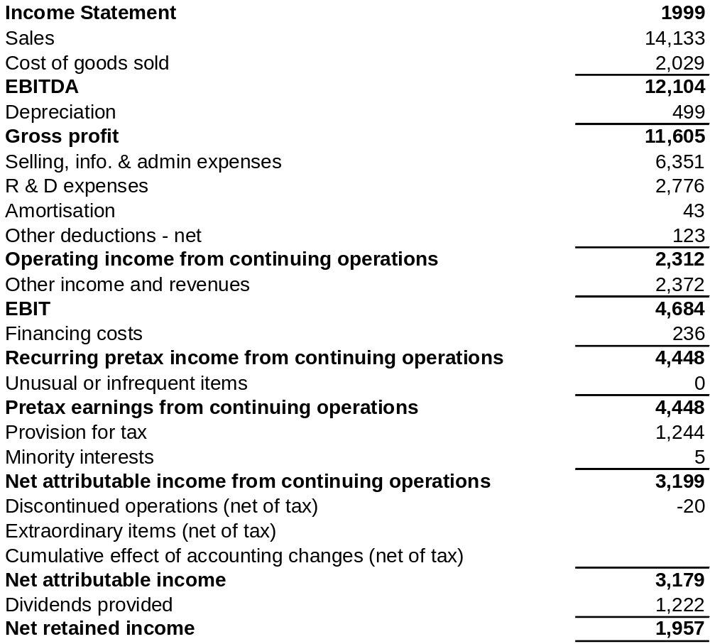
Objective 1.4
Income statement format
Notes:
INSERT “SUGGESTED FORMAT FROM PAGE 35 OF WHITE ET AL

Slide 21
Objective 1.4
Income statement components
Gross profit
  Generated by revenue from sale of goods and services of a firm’s continuing operations less the cost of manufacturing or purchasing them
  It is independent of the firm’s capital structure
  The profit at this level belongs to creditors, the government and shareholders
Operating income from continuing operations
  Gross profit less the indirect cost of selling and administrative activities together with expense categories such as research and development
Recurring income before interest and taxes from continuing operations
  Operating income from continuing operations plus other income such as interest and dividend income and gains and losses on disposal of assets

Slide 22
Objective 1.4
Income statement components
Recurring pretax income from continuing operations
  Recurring income before interest and taxes from continuing operations less financing costs
  It is not independent of the firm’s capital structure
  The profit at this level belongs to the government and shareholders
Pretax earnings from continuing operations
  Recurring pretax income from continuing operations plus unusual and infrequent items such as pretax gains from sale or impairment of assets
Net income from continuing operations
  Pretax earnings from continuing operations less income tax expense
  The profit at this level belongs to the shareholders

Slide 23
Objective 1.4
Income statement components
Net income
  Net income from continuing operations plus income from discontinued operations after tax, extraordinary items after tax and the cumulative effect of accounting changes after tax

Slide 24
Objective 1.4
Balance sheet components
Current assets and liabilities are defined by their liquidity
  Current asset are expected to be converted into cash or used within one year
  Current liabilities are obligations the firm expects to settle within one year
Current assets include:
  Cash and cash equivalents: risk-free securities maturing under 90 days
  Marketable securities: equity securities valued at market and money market securities carried at cost of amortised value
  Accounts and notes receivable: trade receivables net of allowance for bad debt plus notes
  Inventories

Slide 25
Objective 1.6
The role of the auditor
The auditor must be an independent certified public accountant
The auditor is responsible for:
  Verifying that the financial statements issued by a firm conform to GAAP
  Examining the firm’s accounting and internal control systems
  Confirming the accuracy of the firm’s statement of assets and liabilities
  Ensuring that there are no material errors in the financial statements
  Drafting an audit report or opinion, which is presented with the financial statements of the firm

Slide 26
Objective 1.6
The audit opinion
The matters to be addressed by the auditors in the opinion are set defined in Statement of Auditing Standards (SAS 58) and include statements that:
  The financial statements are prepared by the firm and are the responsibility of management and that the auditor has performed an independent audit of them
  The audit was conducted in accordance with the generally accepted auditing standards (GAAS) that require the auditor to provide “reasonable assurance” that there are no material errors in the financial statements
  The financial statements were prepared in accordance with GAAP and that the accounting principles chosen and the estimates employed are reasonable
  Set out any material uncertainties affecting the financial statements, such as doubts concerning the “going concern” assumption, valuations, or litigation

Slide 27
Key Points

Slide 28
Excluded CFA learning objectives
Discuss the factors influencing and leading to diversity in accounting and reporting practices throughout the world and explain why worldwide accounting diversity causes problems for capital market participants;
Discuss the importance of the hierarchical model of accounting diversity;
Discuss the arguments for and against harmonization and discuss the role of the International Accounting Standards Board (IASB).

